Slide 1
Project Progress Review
Hamzah Malik – ACSF375.

Slide 2
Problem Domain
Using Augmented Reality for a restaurant menu-based system.
Aimed at:
Restaurant Owners
Customers who dine at restaurants
Is there a way for restaurant owners to create immersive story-driven experiences for their customers, without the worry of major expenses?

Slide 3
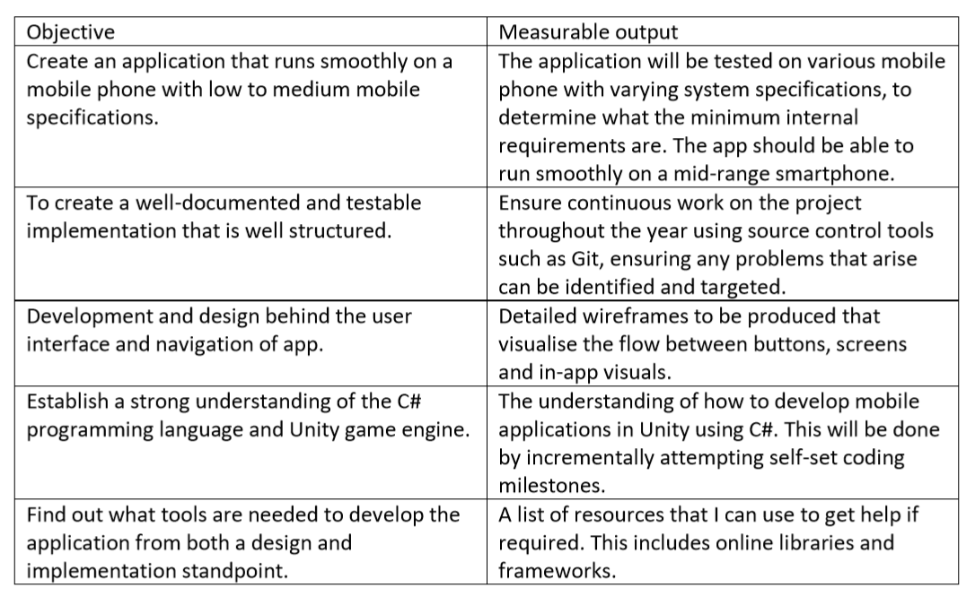
Project Objectives

Slide 4
Work Completed So Far
PDD updates based on feedback given.
Requirements Drafts.
Requirement Specification Document.
Wireframing for App Layout
Project Research
Unity experimentation and game development within Unity.

Slide 5
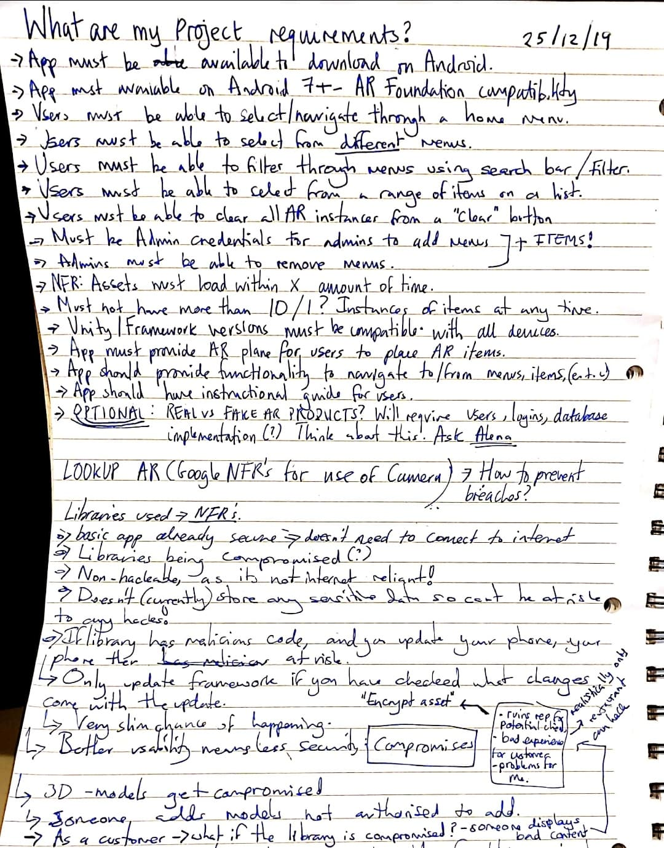
Project Requirement Draft

Slide 6
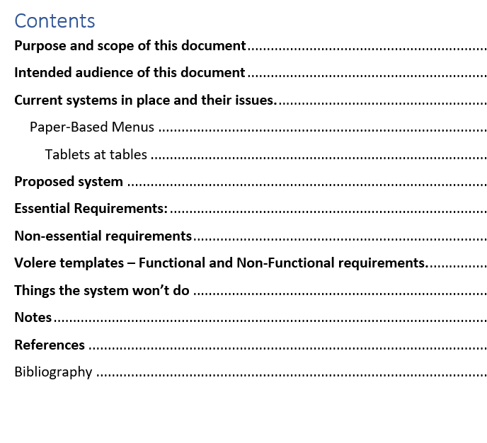
Requirements Specification Document

Slide 7
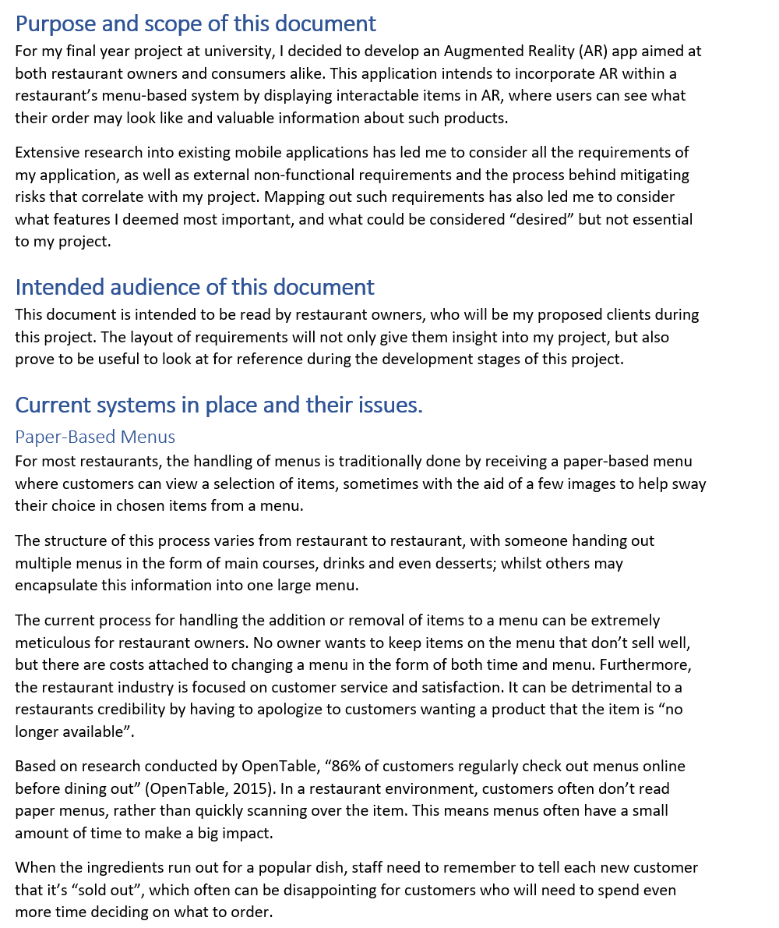

Slide 8
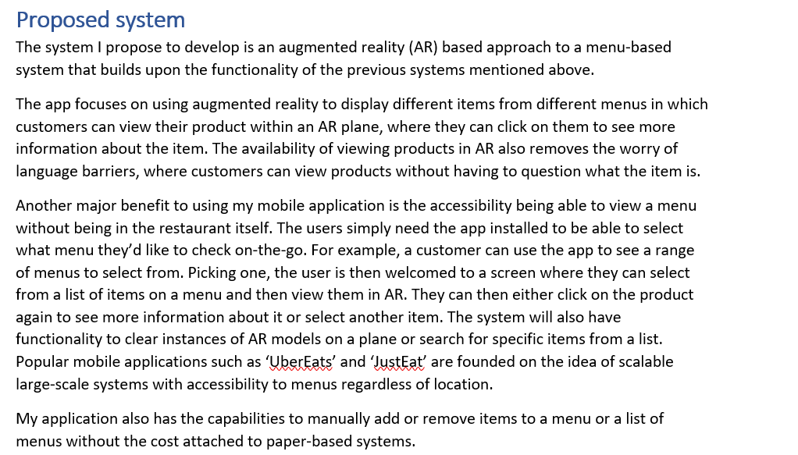

Slide 9
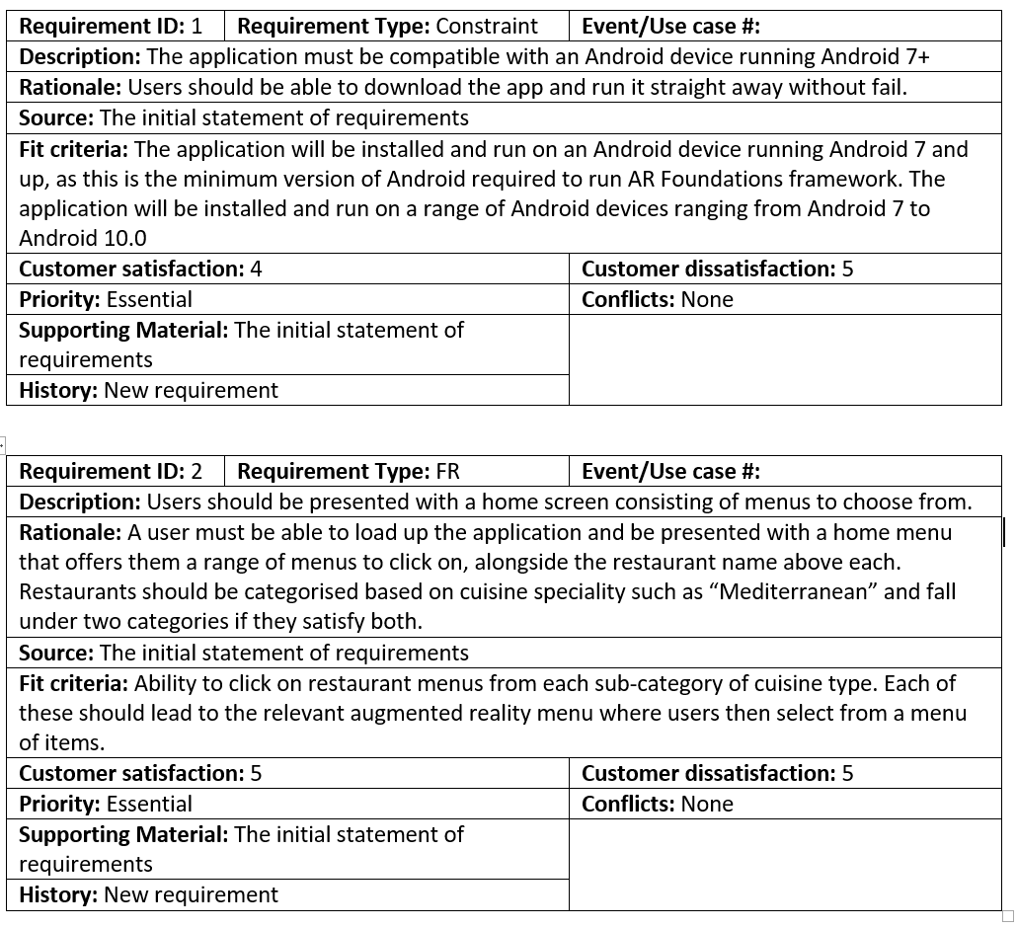

Slide 10
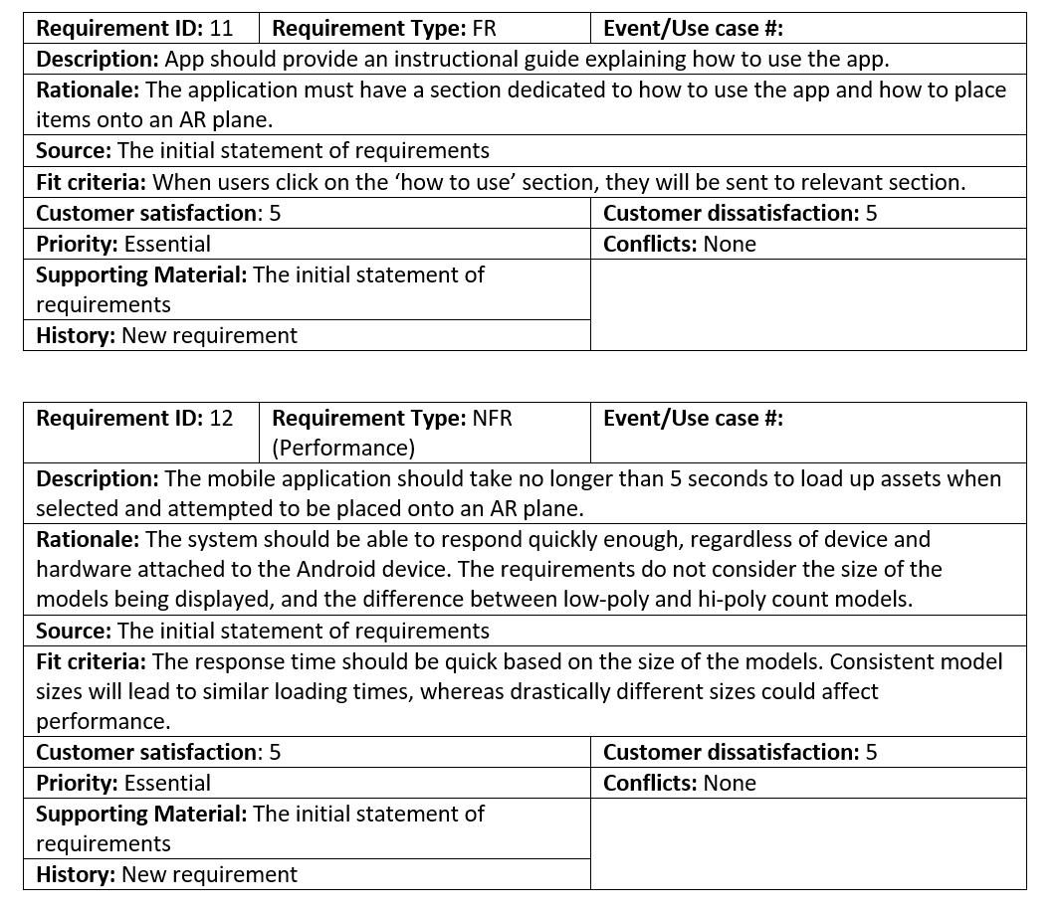

Slide 11
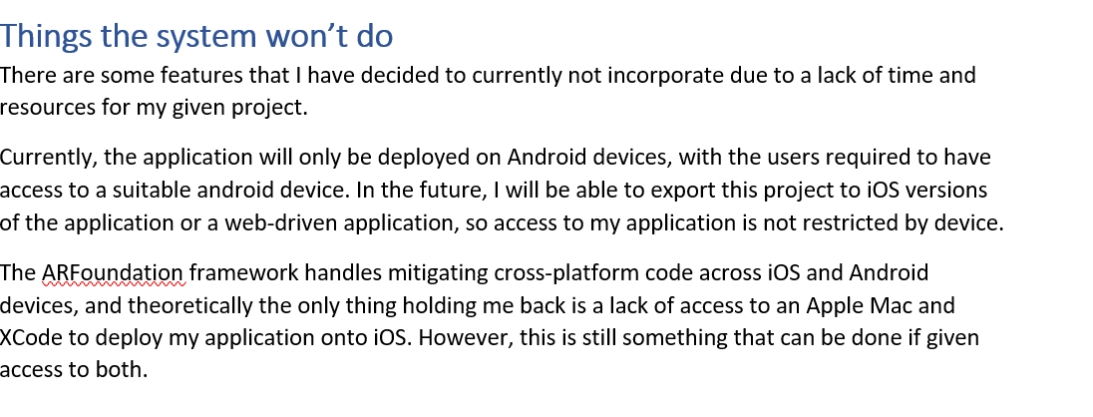
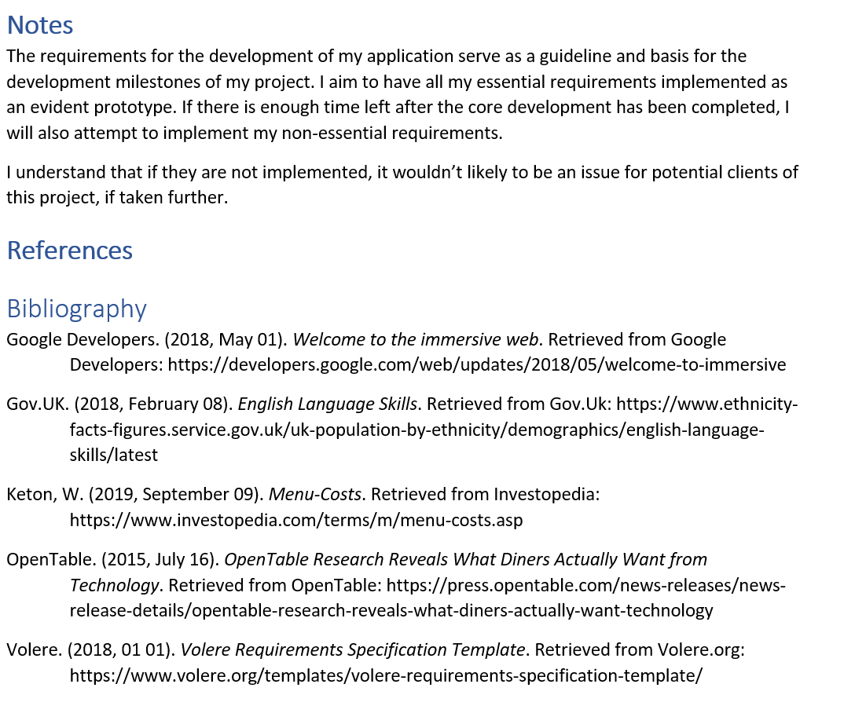

Slide 12
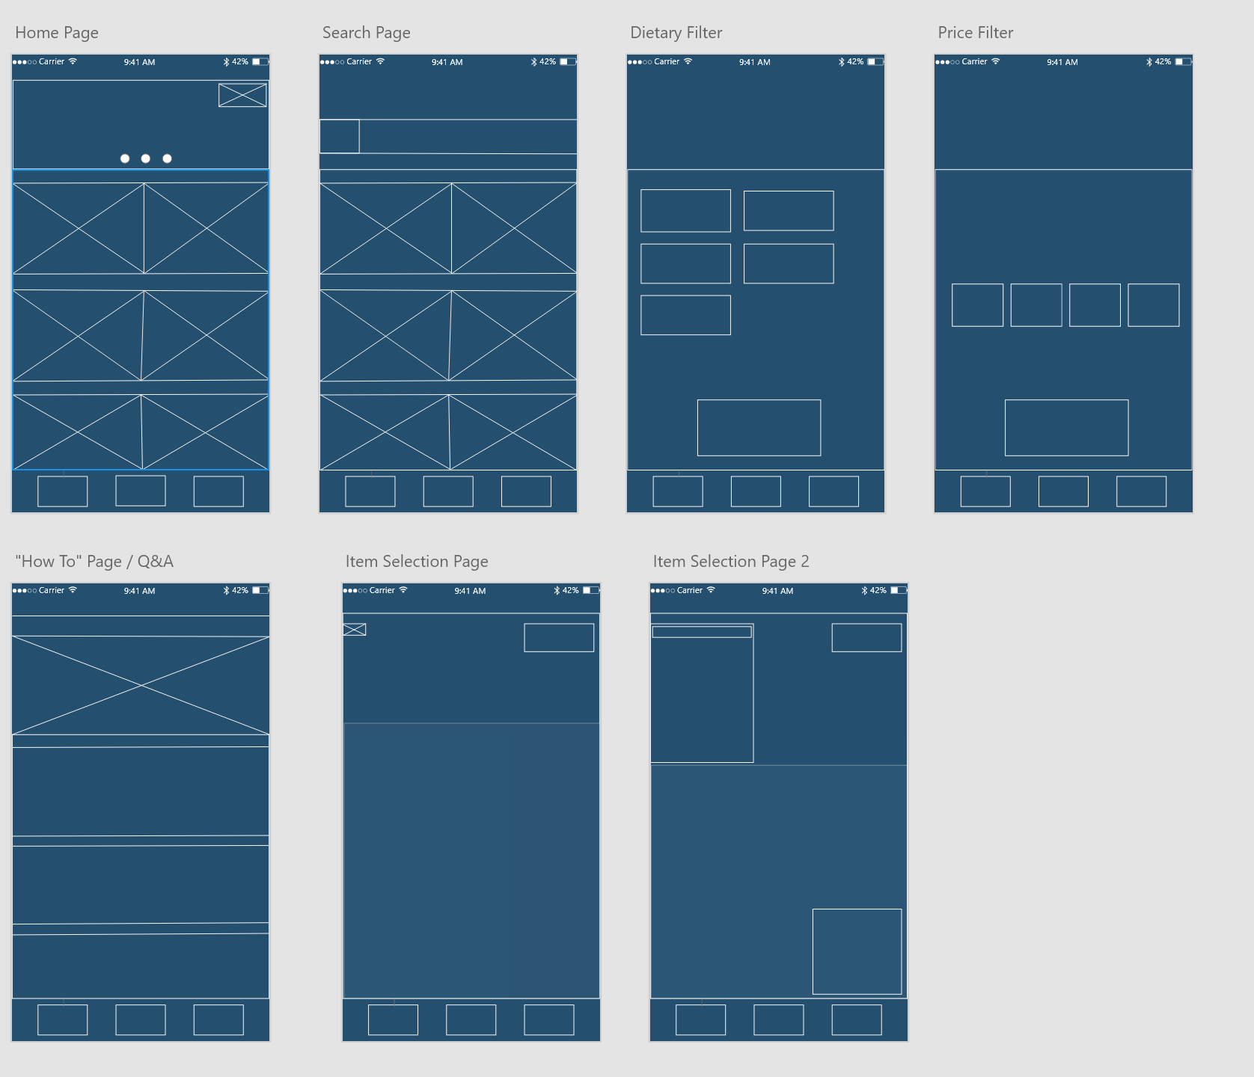
Wireframe Design Layout

Slide 13
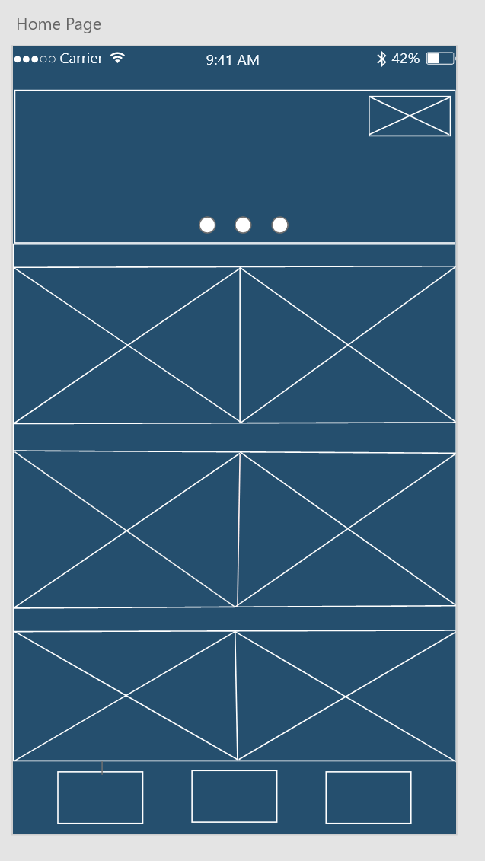
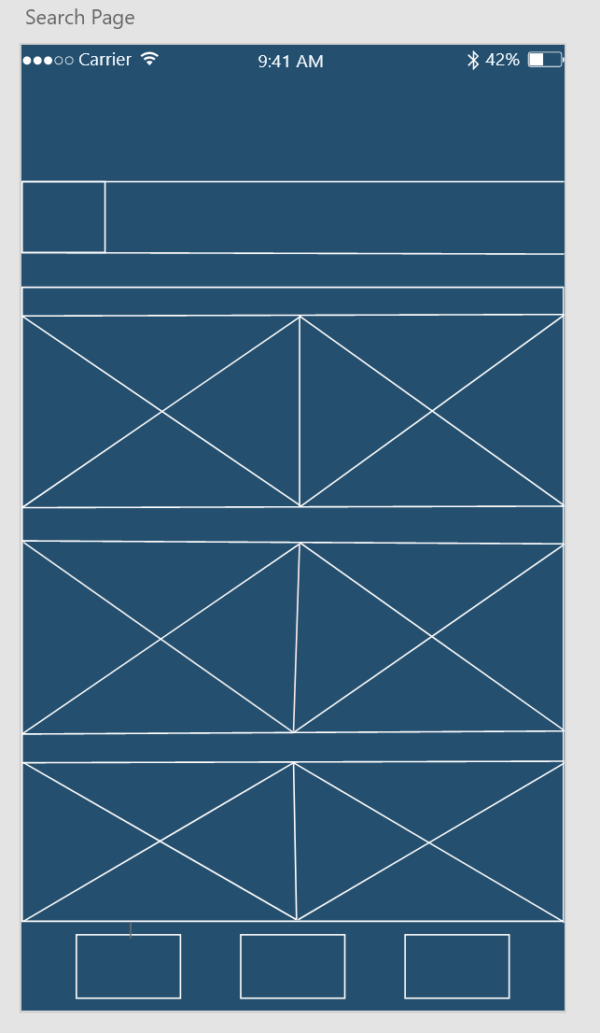
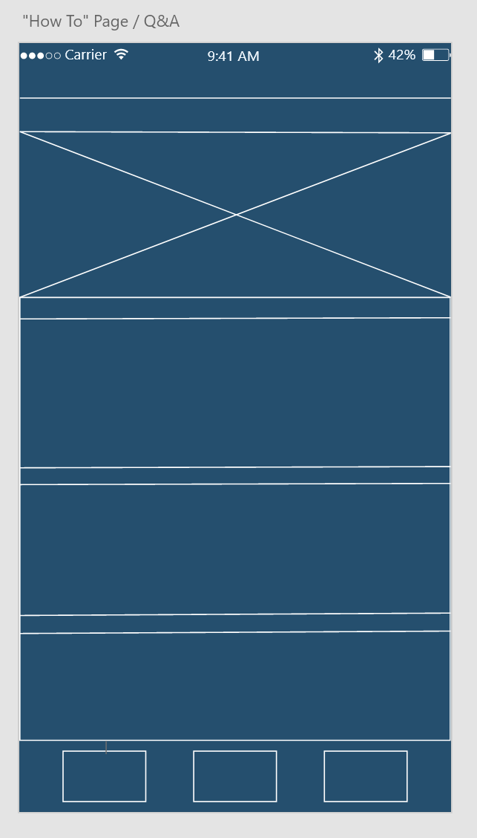
Home page of app
Search Page
How To

Slide 14
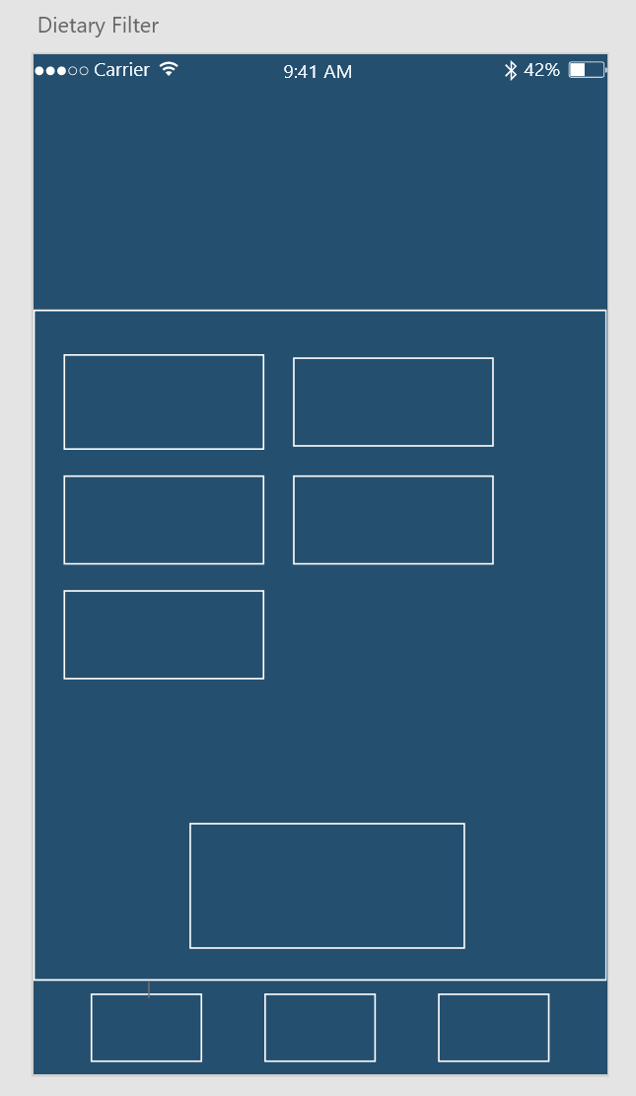
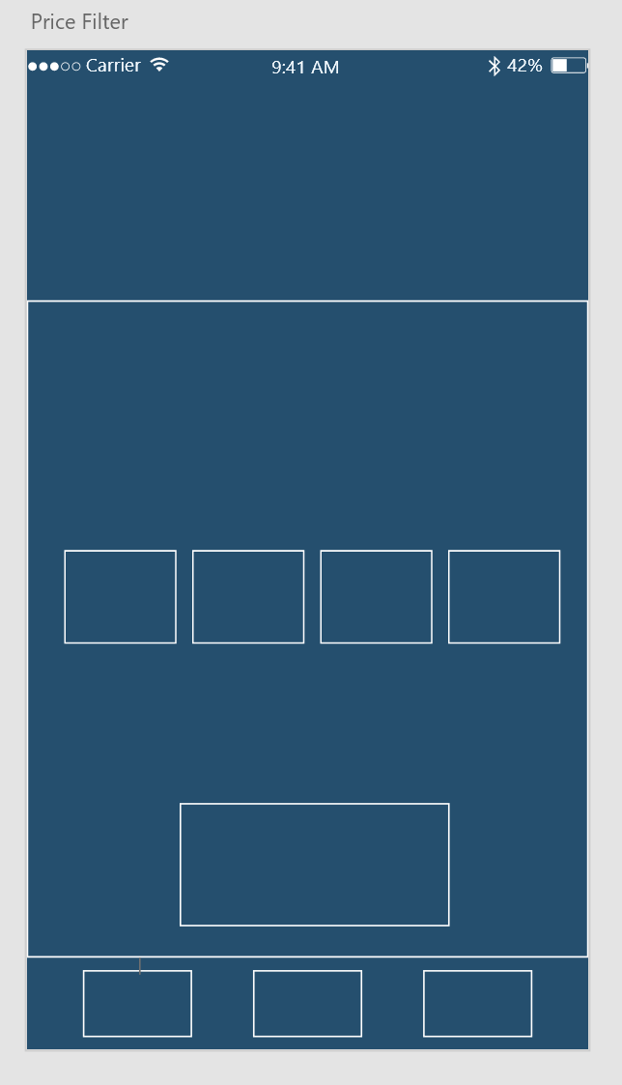
Dietary Filter
Price Filter

Slide 15
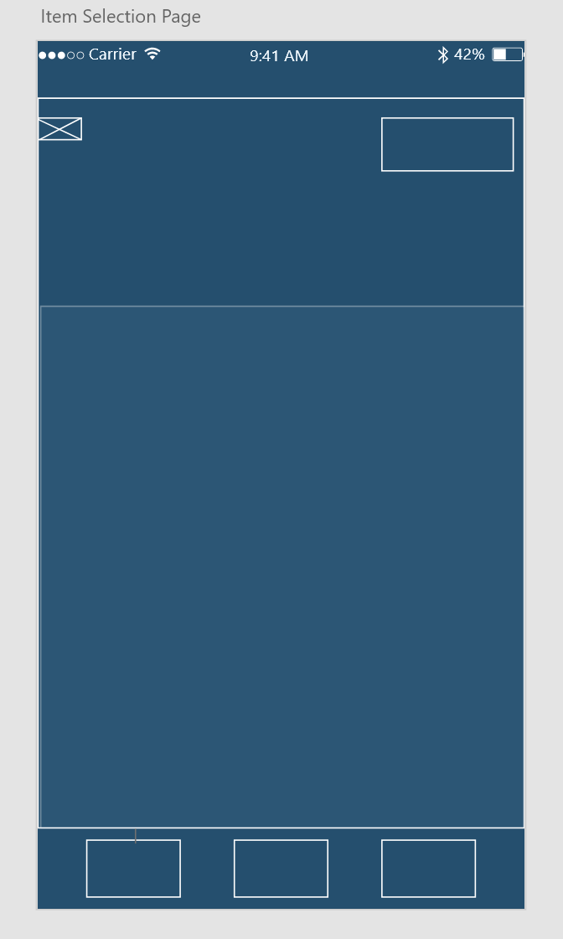
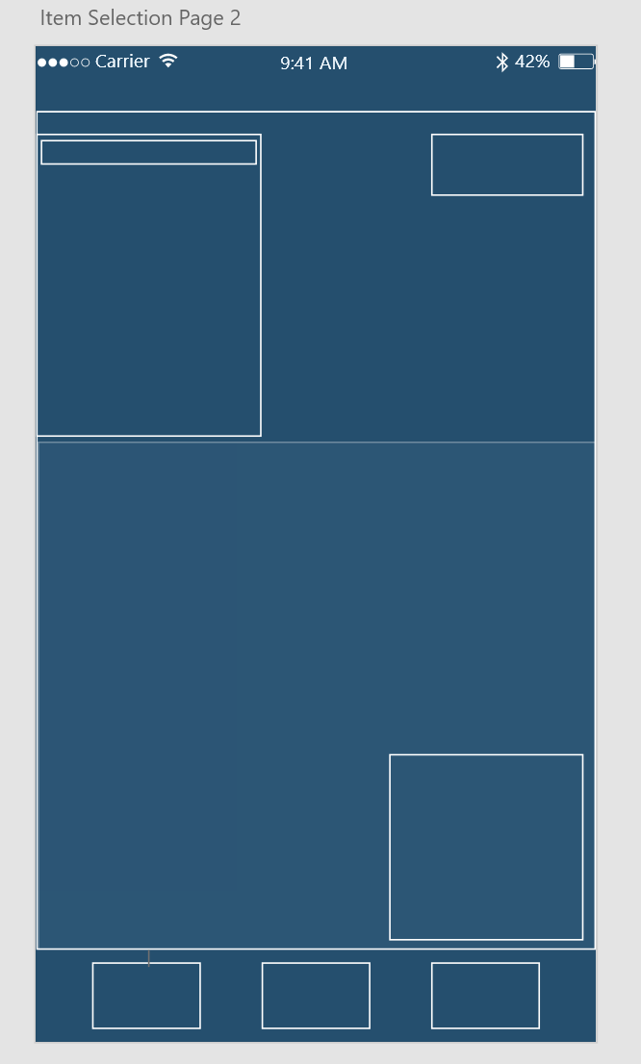
Item Selection Page
Item Selection Page 2

Slide 16
Leveraging Existing Brands
UberEats, JustEat, Deliveroo are of the top online food ordering platforms currently on the market.
Have invested resources into the research and budgeting behind UI layouts and app designs.
User familiarity, people like what they’re used to.

Slide 17
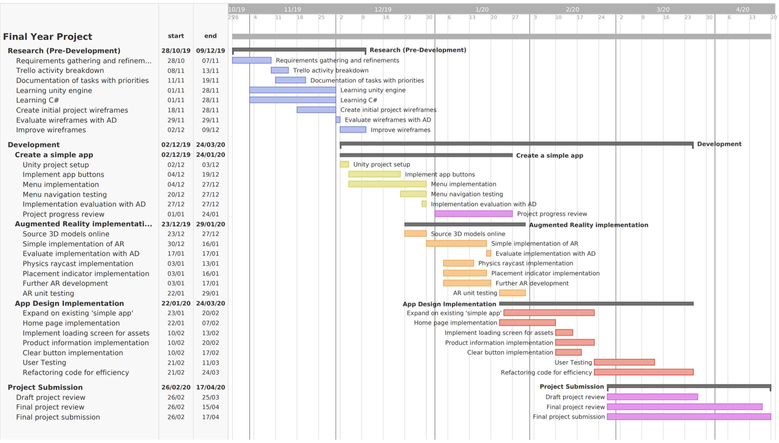

Slide 18
Work-Plan Deviations
Naivety towards how long I’d expect coursework deadlines to take.
Incremental design and development process – establishing a solid concept behind the implementation needed, rather than going straight into development.
Coursework deadlines and exams weren’t factored into my initial work-plan.

Slide 19
Managing workflow
Development milestones set for project
Updated Gantt Chart to reflect new deadlines, with associated testing periods for my project.
Weekly timetable setup to manage my time outside of lectures and tutorials.
Trello board with associated tasks.

Slide 20
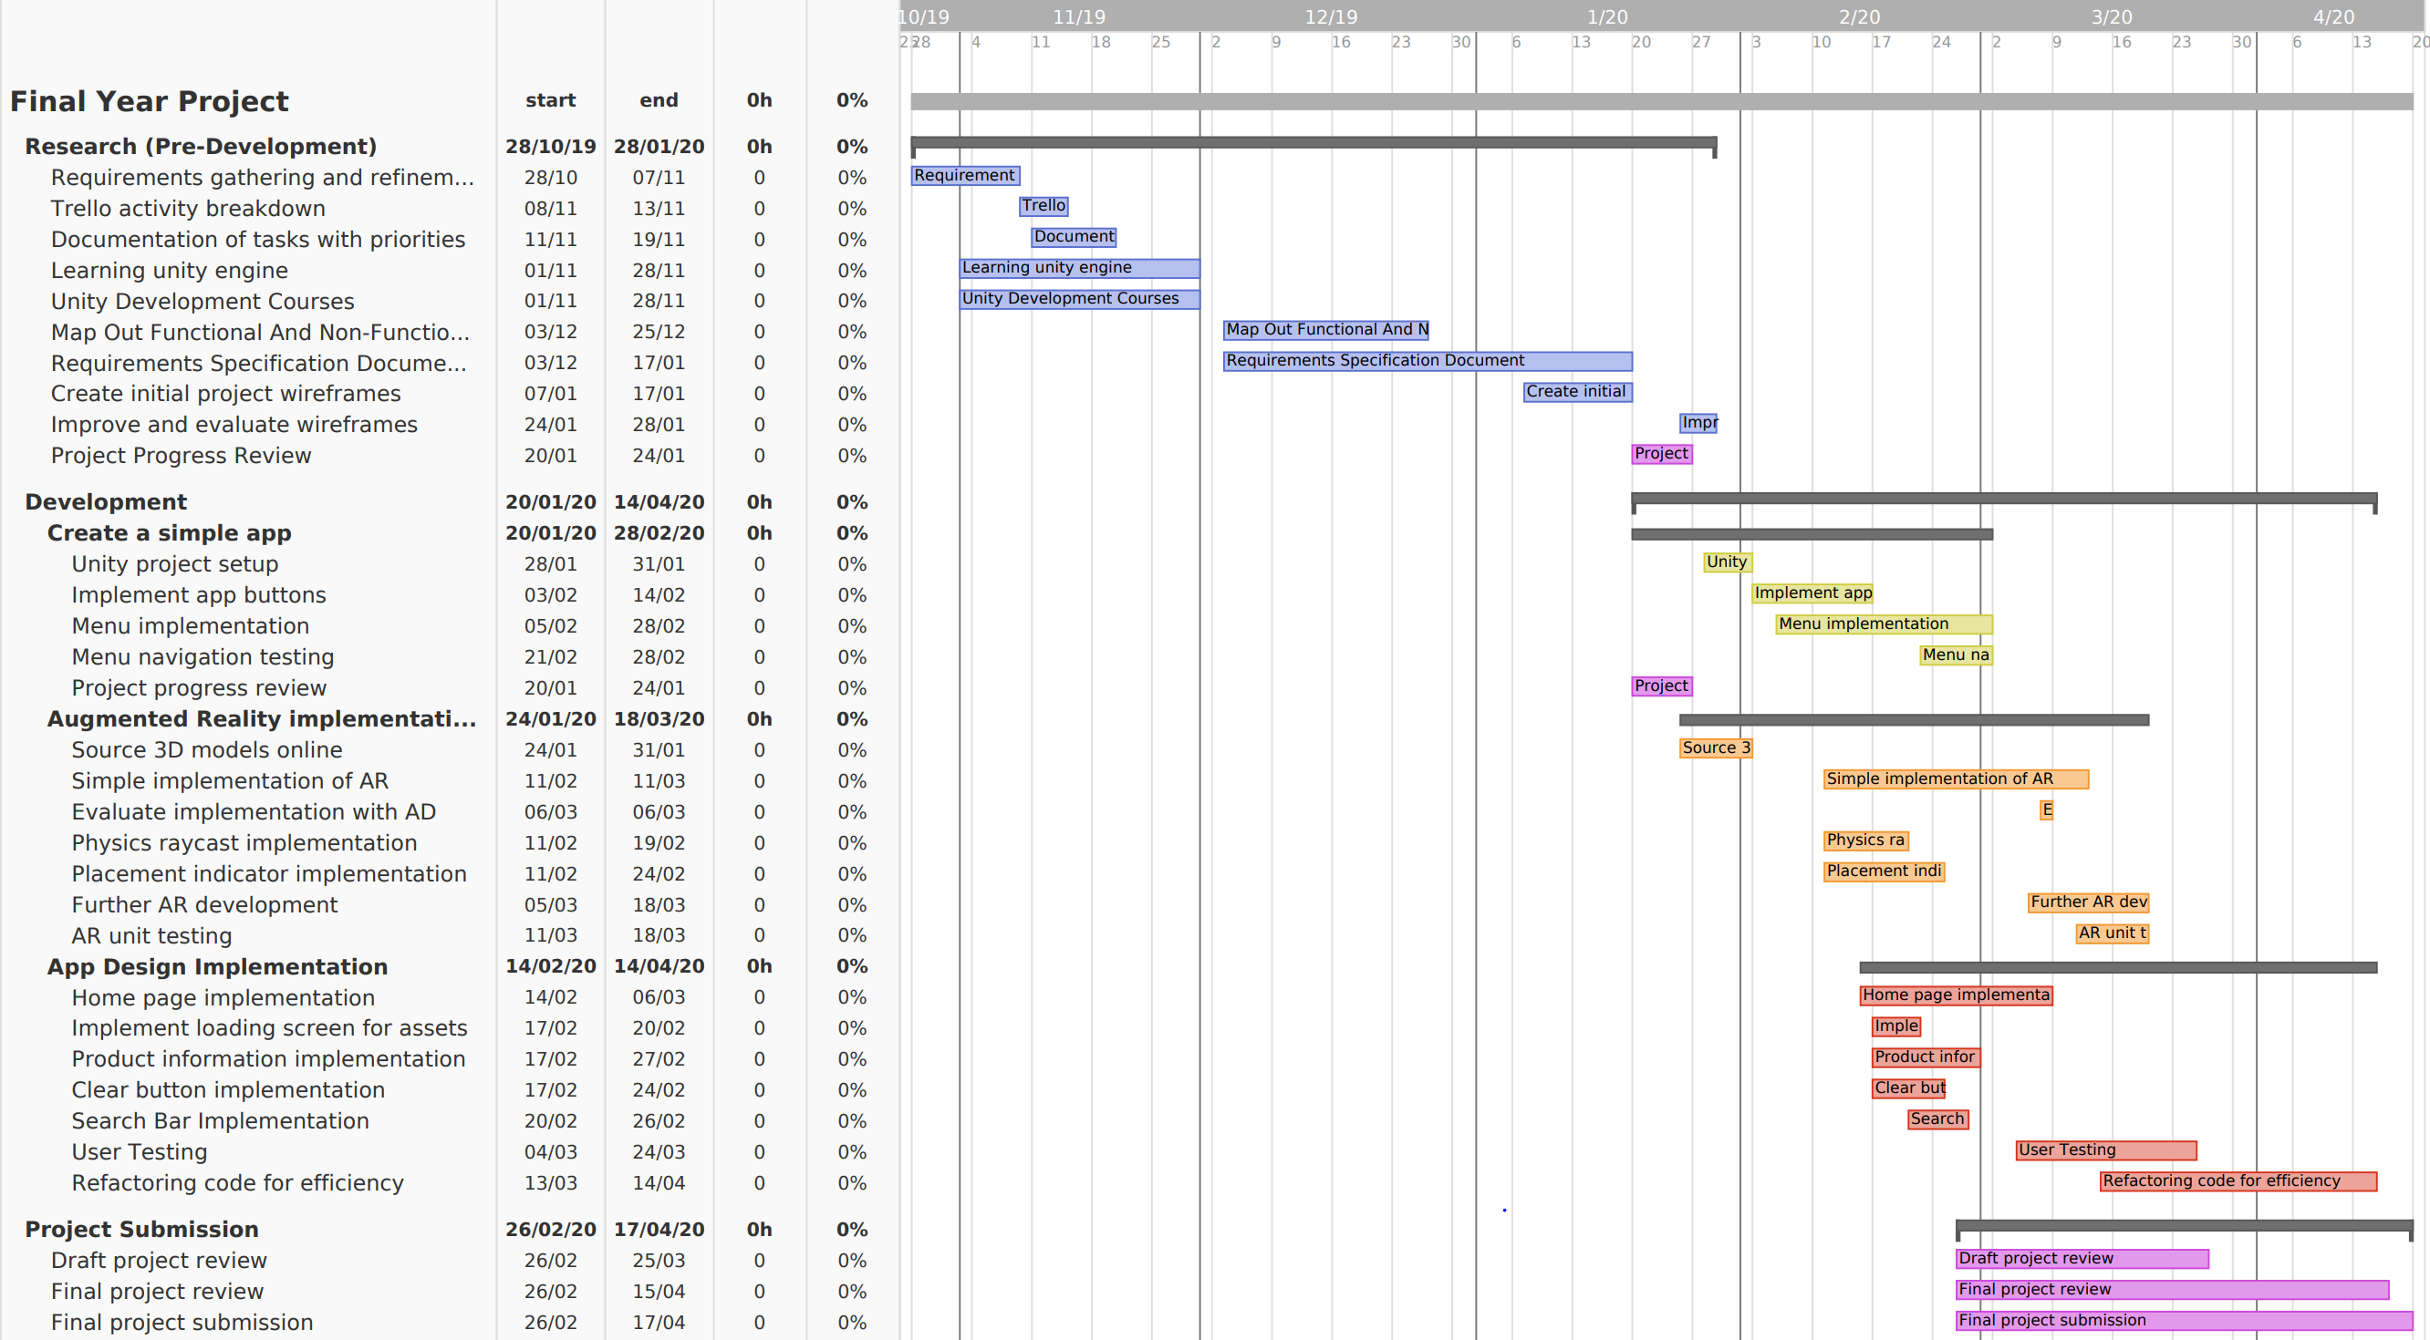

Slide 21
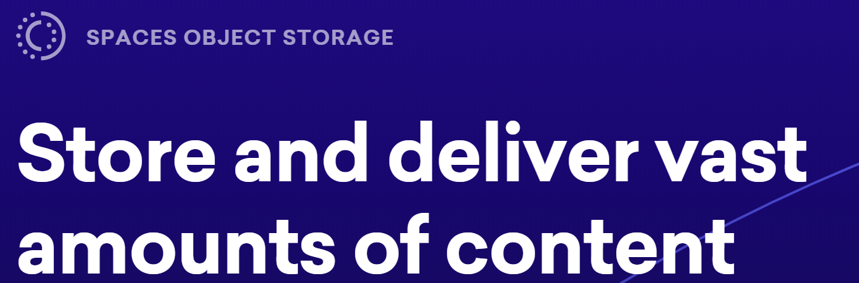
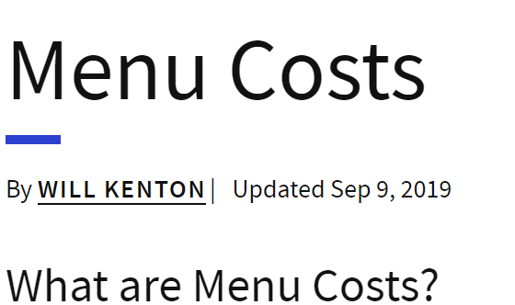

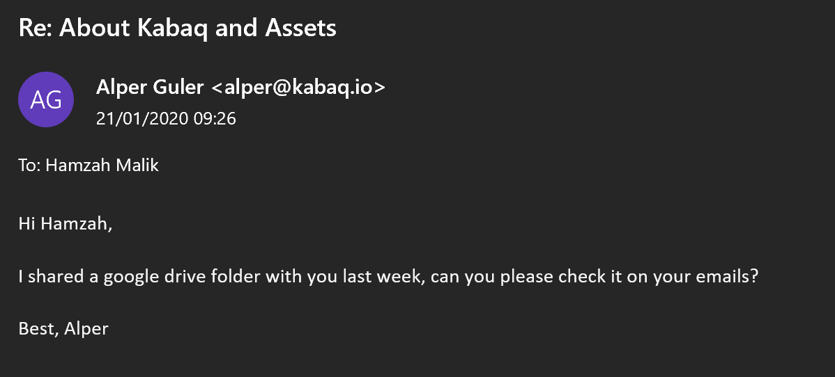


Key-Sources and Reading Material

Slide 22
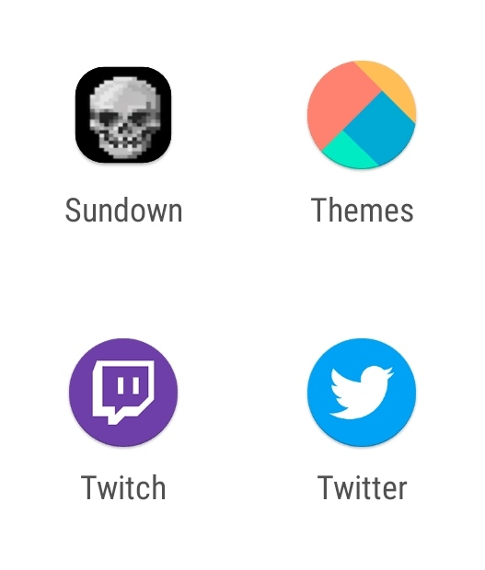
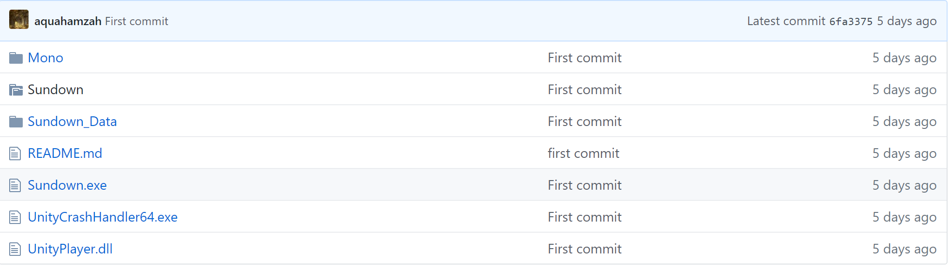
Sundown – A Text Based Adventure.

